Slide 1
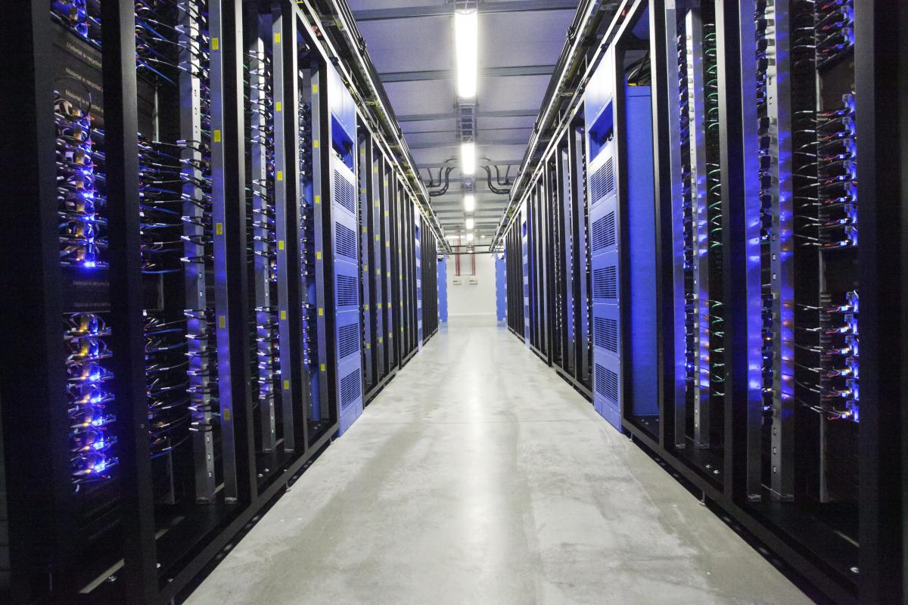
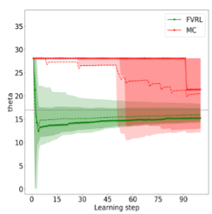
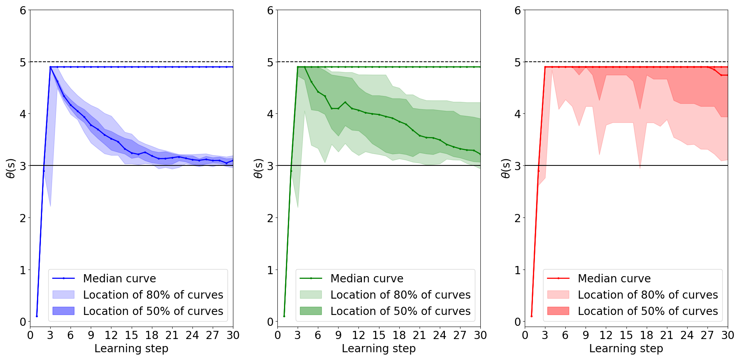




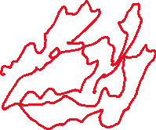
FVRL: Fleming-Viot Reinforcement Learning A method for faster optimization
λ₁
μ
FULL
λ₂
Dispatcher
μ
…
…
λ_{L}
μ
Regular excursion
R
R
S
A
R
Fleming-Viot excursion
R
R
S
Applications to queueing networks
A
R
Daniel Mastropietro, Urtzi Ayesta, Matthieu Jonckheere, Symon Majewski PyData Lausanne, 26-Nov-2025

Slide 2
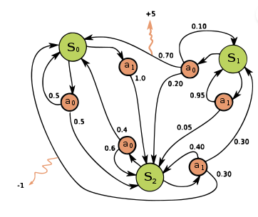
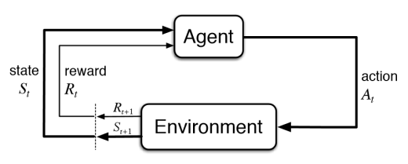
Context: Optimisation of long-term objectives in Markovian systems.
What is RL? Learning from interactions between an agent and the system.
In practice: Optimize by “trial and error”
What is optimized? Actions / Decisions at each state x of the system, i.e. the Policy: π(a|x)
With what goal? Maximize / Minimize a long-term objective. Ex: the long-run expected reward.
X₀
X₁
Markov
Decision
Process
(MDP)
Reinforcement Learning (RL) is an optimisation approach that requires very few modelling assumptions.
X₂
Source: Wikipedia
X_{t}
R_{t}
π(a|x)
X_{t}
R_{t+1}
A_{t}
X_{t+1}
Environment
Environment
exploration
Signal returned (reward)
The data for learning are trajectories:
X₀→ A₀ → R₁ → X₁ → A₁ → R₂ → …
A₀
A₁
Defined stochastically by policy π(a|x)
Note: Depending on the problem, rewards may be actually “costs”.
Notes:
MDP = Markov process driven by decisions

Slide 3
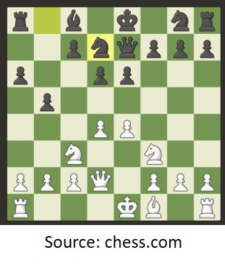

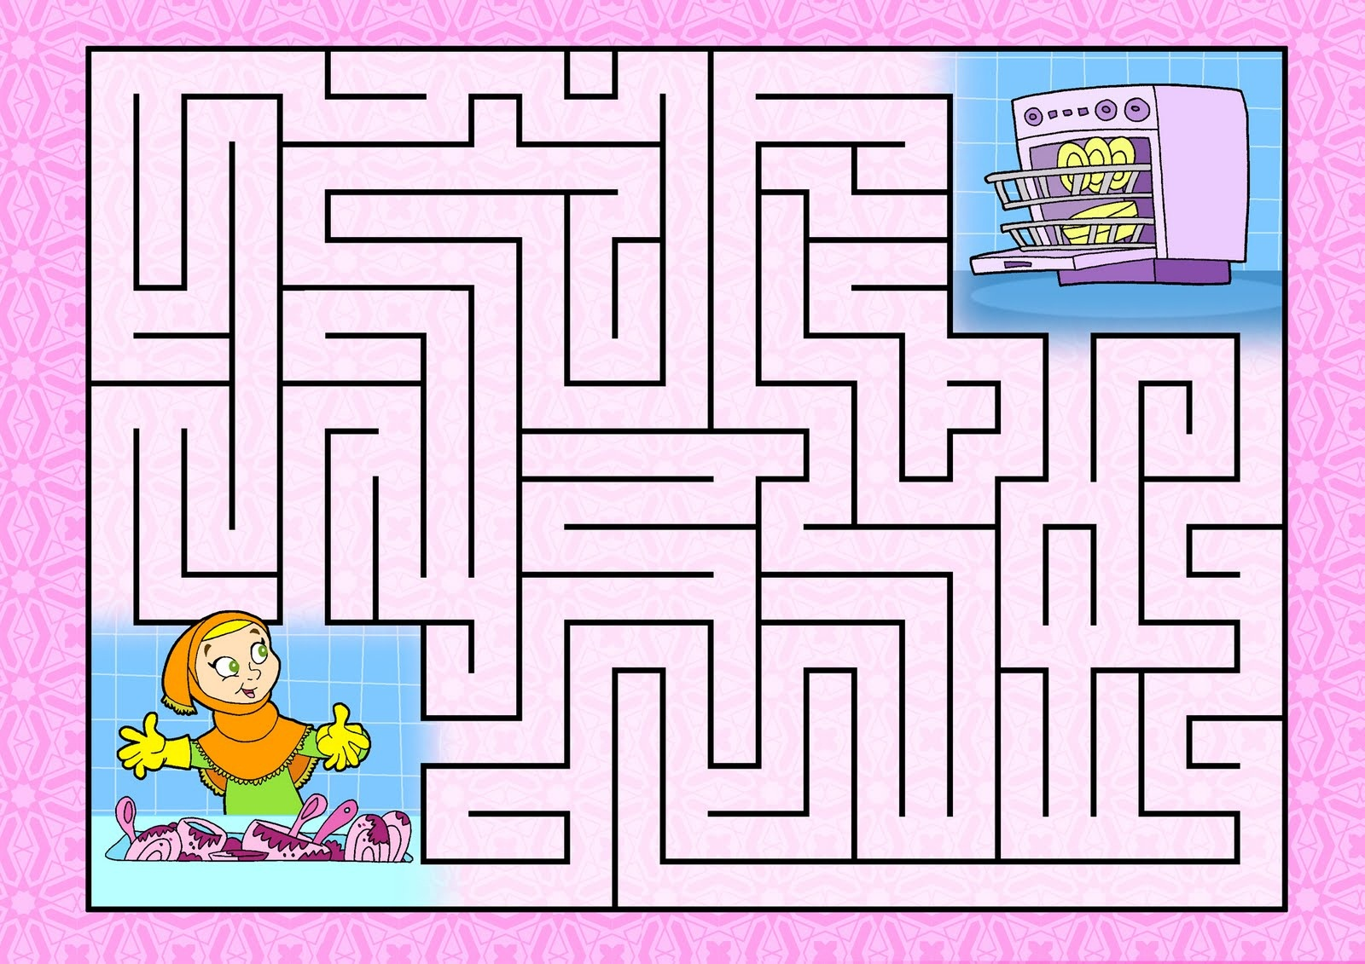
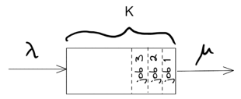
RL Examples
Games
Business
Problem
BLACK OUT
FULL
Long-term objective
Win the game.
Quality of Service with limited resources.
Board configuration.
Player position.
No. jobs in service.
Energy demand.
States
(X_{t})
Move a piece.
Move the player.
Accept/Reject a job.
Deliver/Cut distribution.
Actions / Decisions (A_{t})
Value of piece taken. Prize is found.
Cost of rejection.
Cost of black-out.
Rewards
(R_{t})

Slide 4
Advantages and Disadvantages of RL
ADVANTAGES Little model requirements (Markovian assumption is enough)
Complex optimisation problems
Online learning
Can handle non-stationarity
DISADVANTAGES Time and resource consuming (Exploration of all the environment)
Balance exploration (of environment) vs. exploitation (of signal)
X_{t}
R_{t}
X_{t}
R_{t+1}
A_{t}
X_{t+1}
Environment
Our goal:
Reduce time and resource consumption by increasing exploration efficiency so that the signal can be exploited faster.

Slide 5
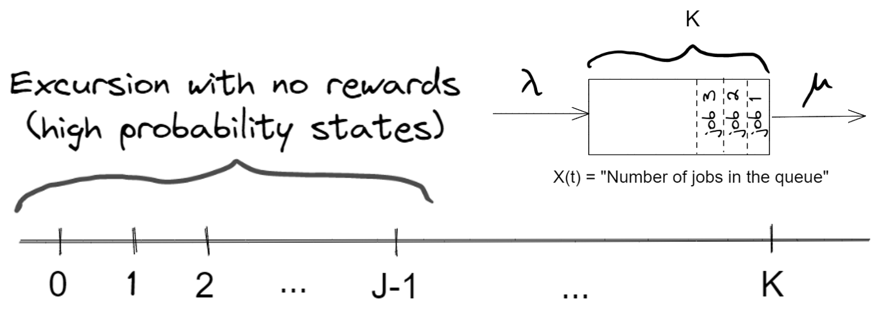
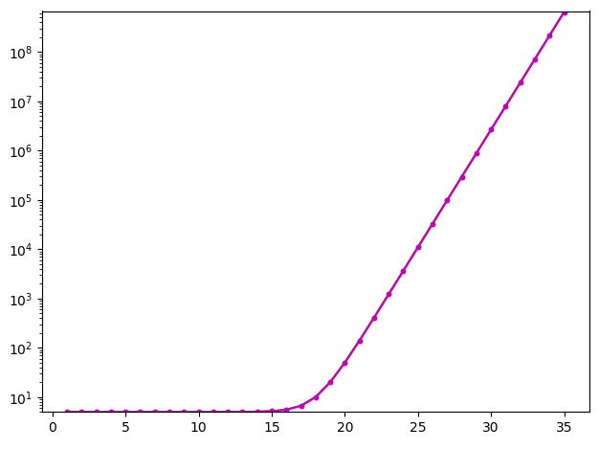
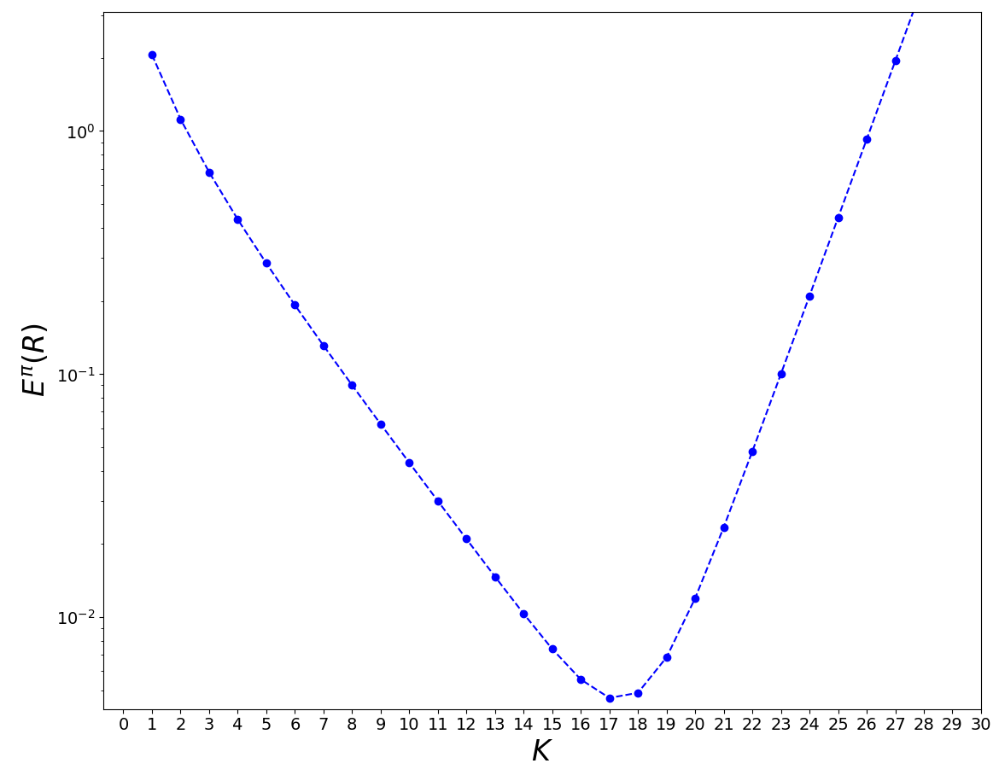
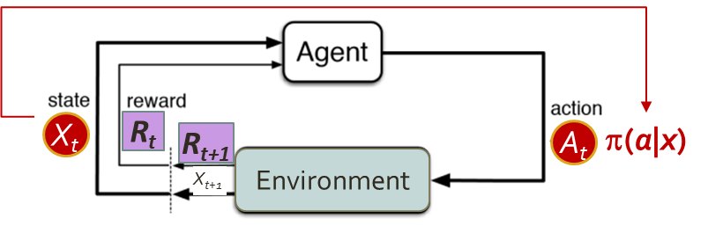
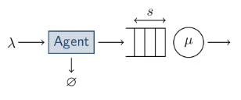
Motivating example A simple queueing system where rewards are rare Queue system dimensioning
M/M/1 queue
λ: job arrival rate (exponential inter-arrival times)
μ: service rate (exponentially distributed times)
X(t)
X(t)
State space (1D)
x
Rejection cost as a function of x (log scale)
Given that:
There are NO job holding costs.
There is a rejection cost of an incoming job that increases with the queue size X(t) at the time of rejection.
Goal:
Design a threshold-type job admission control policy π(a|x) that minimizes the average cost in the long-run.
Notes:
Two possible actions a: Accept or Reject an incoming job.
The Acceptance / Rejection threshold defines how many jobs the queue can hold (its capacity K) => The goal is to optimize K.
x
Average cost in the long-run
(log scale)
x
K
Optimum K

Slide 6


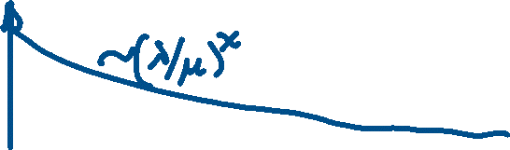
Motivating example A simple queueing system where rewards are rare Queue system dimensioning
Stationary occupation probability decreases exponentially with x:
P(X(t) = x) ~ (λ/μ)^{x} (when λ < μ)
= ?
How to dimension the capacity of the queue using RL?
X(t)
X(t)
“Attraction” set A
Sketch of typical excursion of process X(t) = “No. of jobs in the queue”
The states in A are frequently visited BUT give no cost information (zero reward)
If no rejection (queue blocking) is observed…
the average cost will be estimated as ZERO
x
It will be difficult to optimize K
to minimize the average blocking cost

Slide 7
(Summing up) Our goal
Develop an RL algorithm for sample-efficient solution of stochastic optimisation problems

Slide 8
(Summing up) The framework
Optimize a long-term objective (average cost)
whose value depends on decisions taken over time (accept/reject job)
potentially affected by large rare rewards (rejection cost)
Mathematical framework: Markov decision processes (MDP)
Methodological framework: Reinforcement learning (RL)
Optimisation output: Policy π = Probability(action | state)

Slide 9
(Summing up) Why Reinforcement Learning (RL)?
RL is model-free and can find optimal policies by trial and error
It’s appealing for solving complex optimisation problems (difficult to model or highly nonlinear)

Slide 10


(Summing up) but there are challenges
How long it takes to find an optimum?
Computing intensive → How to discover the environment efficiently in large configuration spaces?
Uneven probability distribution → A few states could be rarely visited but yield very large rewards impacting optimisation…
Large reward
Visit probability decreases as state x gets closer to the reward
Efficient exploration (to find rewards) is one of the main problems in RL

Slide 11
Existing methods
METHOD
DESCRIPTION
CHALLENGE
Importance Sampling
Alternative exploration policy to boost visit of rare events.
Not always possible to apply. (ex. Queue)
Reward shaping
Engineer rewards to help learn faster.
Requires domain knowledge.
Curiosity-driven methods
Bonus in objective function to encourage exploring elsewhere.
Bonus choice may be challenging for good balance between exploration vs. exploitation.

Slide 12
Our proposal: FVRL (Fleming-Viot RL)
METHOD
DESCRIPTION
CHALLENGE
FVRL (Fleming-Viot RL)
Curiosity-driven method, where bonus is replaced with forcing exploration away from frequently visited states.
Requires a simulator.

Slide 13
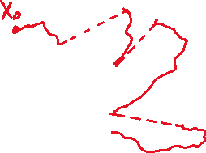
Our proposal: FVRL (Fleming-Viot RL) Leverage information about frequently visited states to force exploration elsewhere
Main idea
Underlying process
Modified process
R
R
S
R
R
S
The process stays away from the set of “atraction” states A
Rare states R are observed more frequently => the process has higher sample-efficiency for discovering R states.
A
A
R
R
Set of states
A trajectory starts near and is forced outside.
S
A
A trajectory of the process, mostly visiting “atraction” states
A
Set of “Atraction” states: frequently visited & possibly zero-reward states
R
A
R
Set with rarely observed states with potentially large rewards
R
A
known or easily learned
R
unknown

Slide 14
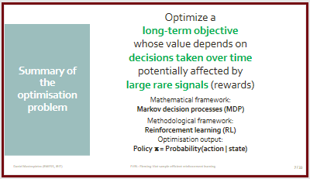
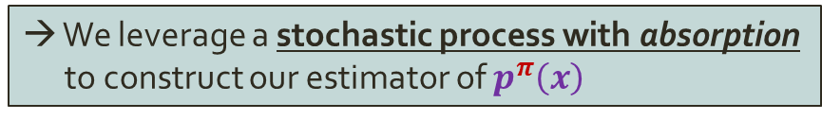
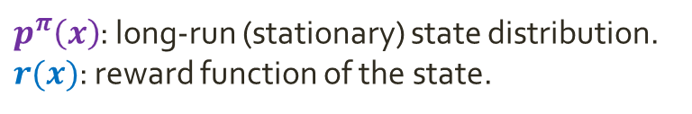

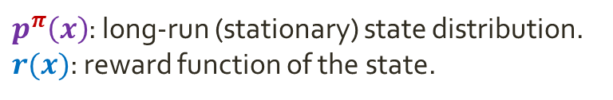



Our proposal Efficiently estimate the stationary state distribution p^{π}(x)
$$E^{π}\left(R\right)=\sum_{x}{p^{π}\left(x\right)r(x)}$$
$$E^{π}\left(R\right)=\sum_{x}{p^{π}\left(x\right)r(x)}$$
We consider problems where the long-term objective is the
long-run expected reward
$$E^{π}\left(R\right)=\sum_{x}{p^{π}\left(x\right)r(x)}$$
unknown / known
$p^{π}\left(x\right)$: long-run (stationary) state distribution.
$r(x)$: reward function of the state.
$p^{π}\left(x\right)$: long-run (stationary) state distribution.
$r(x)$: reward function of the state.
Recall the goal of the optimisation problem
Find an optimal policy π = Probability(action | state)
To optimize we need a way to measure the objective function
=> We need to estimate $p^{π}\left(x\right)$ for each possible policy π
We propose a sample-efficient estimator of $p^{π}\left(x\right)$.
Our method replaces this…
…with this.
R
R
S
R
R
S
A
A
R
R
Non-sample-efficient discovery of R states
Sample-efficient discovery of R states
R
R
Remark: A stands for “Atraction” and “Absorption”
→ We leverage a stochastic process with absorption to construct our estimator of $p^{π}\left(x\right)$
A

Slide 15
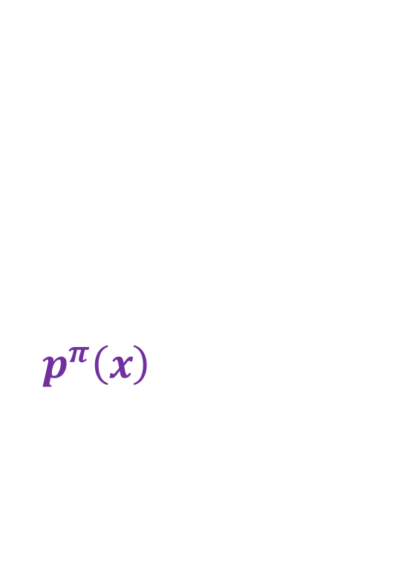

Fleming-Viot particle system helps us estimate $p^{π}\left(x\right)$ efficiently
Stochastic process with absorption
A stochastic process in which the process stops when reaching a certain condition
Stochastic process with absorption
A stochastic process in which the process stops when reaching a certain condition
R
R
S
A
Example: process X(t) stops when reaching a state in A.
R
Fleming-Viot particle system (1979)
Stochastic process constructed on top of a stochastic process with absorption
to model population evolution.
1
N particles evolve in parallel under same policy
2
At some point
a particle is absorbed
Absorbed particle is immediately regenerated
3
R
R
S
R
R
S
R
R
S
A
A
A
R
R
R

Slide 16
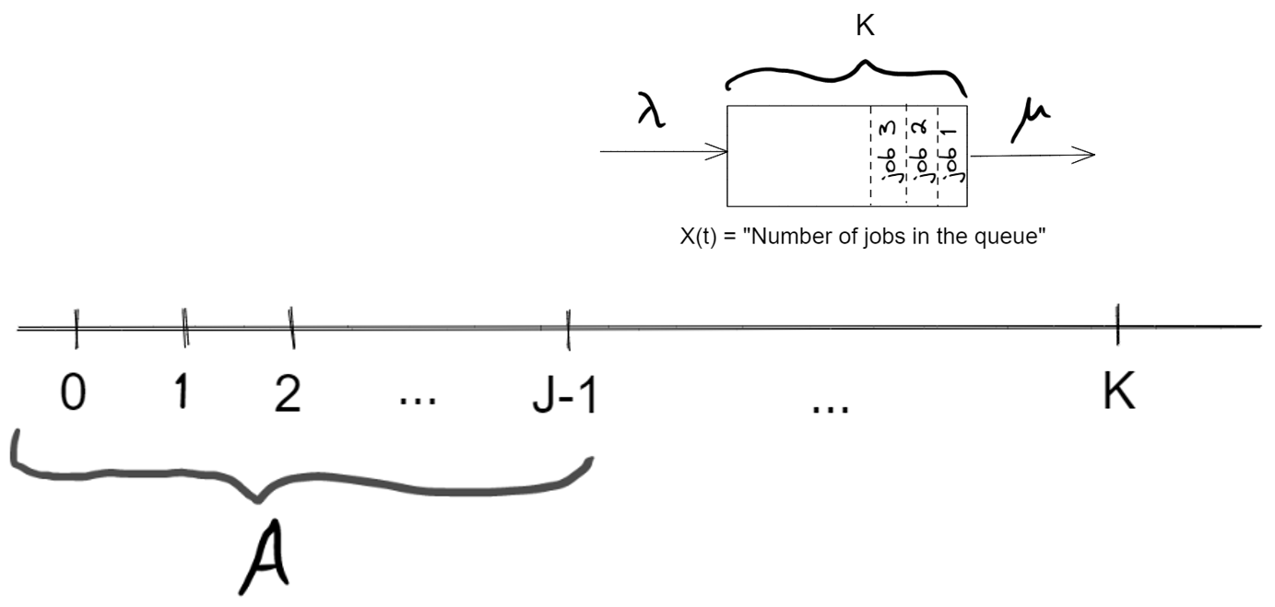
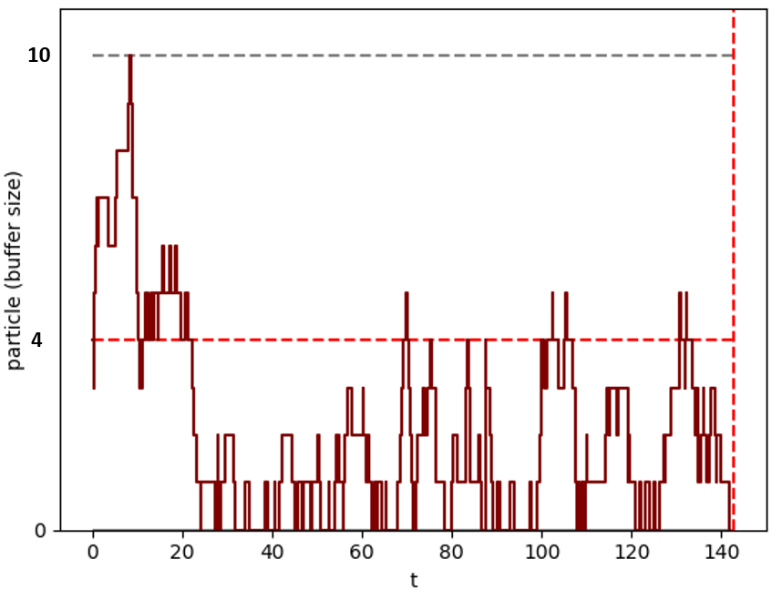
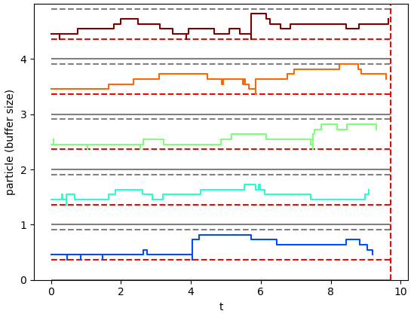
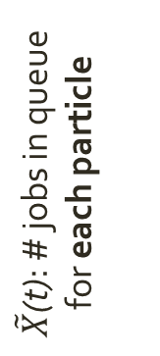
Example: M/M/1/K queue Fleming-Viot process stays closer to the rare reward than original process
M/M/1/K queue characteristics:
- Service load: λ/μ = 0.7 < 1
- Max queue size: K = 10
- Pr(X(t) = K) ~ 0.01
A
R
One realization of underlying process (the MDP)
Fleming-Viot process with J-1=4 A = {0, 1, …, 4} on N=5 particles
A
R
x = 10
P5
x = 10
$\tilde{X}$(t): # jobs in queue for each particle
P4
x = 10
P3
X(t): # jobs in queue
x = 10
P2
x = 10
P1
x
While the number of Markov process transitions is the same in both cases, the Fleming-Viot process tends to be closer to the rare state K with reward
R

Slide 17
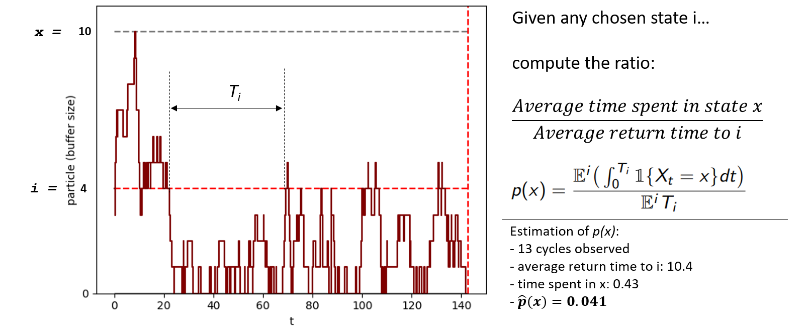
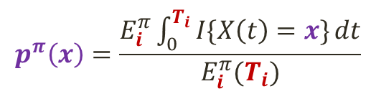



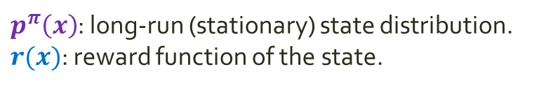
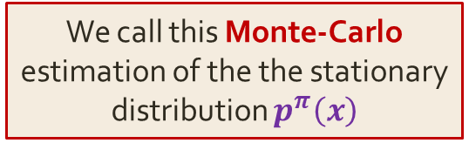
Fleming-Viot estimation of p^{π}(x) is based on renewal theory
Recall our objective…
We consider problems where the long-term objective is the
long-run expected reward
$$E^{π}\left(R\right)=\sum_{x}{p^{π}\left(x\right)r(x)}$$
unknown / known
Renewal theory uses cycles (interval between two consecutive occurrences of the same event) to estimate the stationary distribution p^{π}(x).
M/M/1/K example:
We need $p^{π}\left(x\right)$in state x = K = 10
We choose event “i“: “visit x = 4”
$p^{π}\left(x\right)$: long-run (stationary) state distribution.
$r(x)$: reward function of the state.
$$E^{π}\left(R\right)=p^{π}\left(K\right)r(K)$$
as r(x) = 0, for x ≠ K
One cycle time T_{i}
We call this Monte-Carlo estimation of the the stationary distribution $p^{π}\left(x\right)$
Renewal theorem
$$p^{π}\left(x\right)=\frac{E_{i}^{π}\int_{0}^{T_{i}}{I\{X\left(t\right)=x\}}dt}{E_{i}^{π}(T_{i})}$$
=

Slide 18
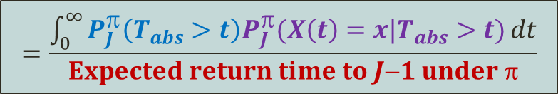
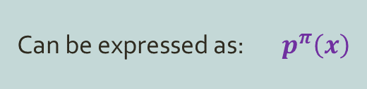
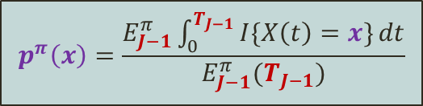

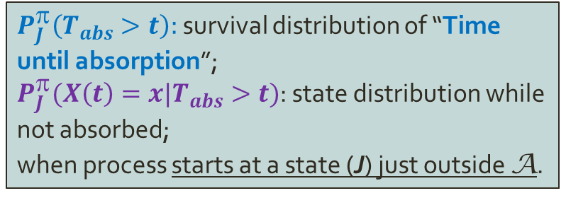


We now apply the renewal theorem on the Fleming-Viot particle system to estimate p^{π}(x)
Recall our objective…
We consider problems where the long-term objective is the
long-run expected reward
$$E^{π}\left(R\right)=\sum_{x}{p^{π}\left(x\right)r(x)}$$
unknown / known
$p^{π}\left(x\right)$: long-run (stationary) state distribution.
$r(x)$: reward function of the state.
Recall the Fleming-Viot particle system…
R
R
S
A
R
We define the event defining a cycle: “Reabsorption to A” (→ i = J-1)
A
$$p^{π}\left(x\right)=\frac{E_{J−1}^{π}\int_{0}^{T_{J−1}}{I\{X\left(t\right)=x\}}dt}{E_{J−1}^{π}(T_{J−1})}$$
$$=\frac{\int_{0}^{∞}{P_{J}^{π}\left(T_{abs}>t\right)P_{J}^{π}(X\left(t\right)=x|T_{abs}>t)}dt}{Expected return time to J−1 under π}$$
Can be expressed as: $p^{π}\left(x\right)$
R
J
$P_{J}^{π}\left(T_{abs}>t\right):$survival distribution of “Time until absorption”;
$P_{J}^{π}(X\left(t\right)=x|T_{abs}>t)$: state distribution while not absorbed;
when process starts at a state (J) just outside A.
J
T_{abs}
R
S
A
J
R

Slide 19
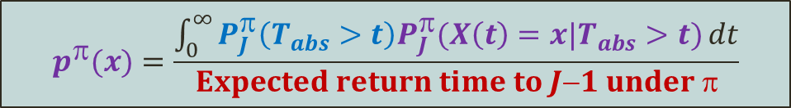
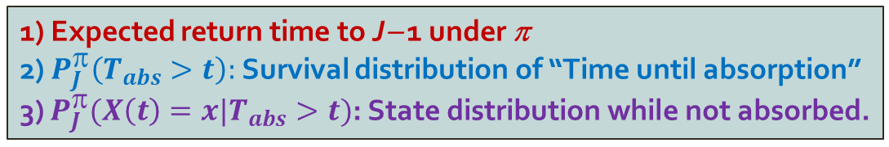
Fleming-Viot estimator of p^{π}(x) requires the estimation of 3 quantities
For states x outside A
A
$$p^{π}(x)=\frac{\int_{0}^{∞}{P_{J}^{π}\left(T_{abs}>t\right)P_{J}^{π}(X\left(t\right)=x|T_{abs}>t)}dt}{Expected return time to J−1 under π}$$
Need to ESTIMATE:
1) Expected return time to J− 1 under π
2) $P_{J}^{π}\left(T_{abs}>t\right):$Survival distribution of “Time until absorption”
3) $P_{J}^{π}(X\left(t\right)=x|T_{abs}>t)$: State distribution while not absorbed.
(moment estimator)
(moment estimator)
(Fleming-Viot
particle system)
The implementation is more complex than the usual uninformed estimation of p^{π}(x) but is able to reach rarely visited states faster...
… and it pays off in terms of sample efficiency.
IMPORTANT: Trajectories are obtained from SIMULATION of the system

Slide 20
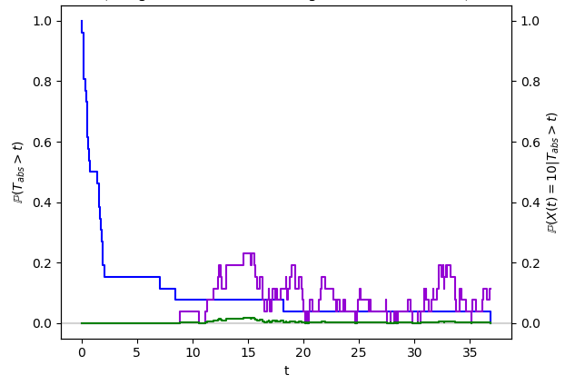
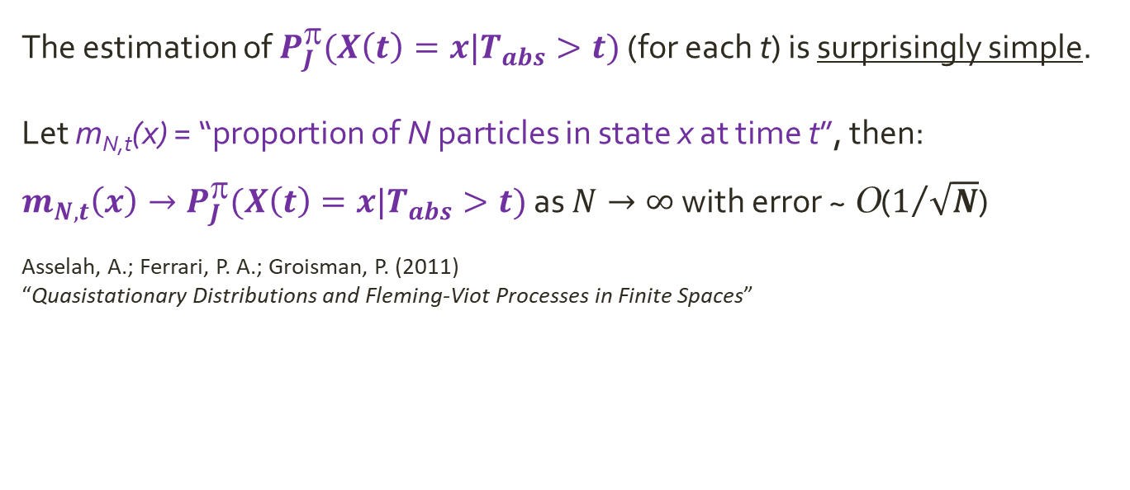
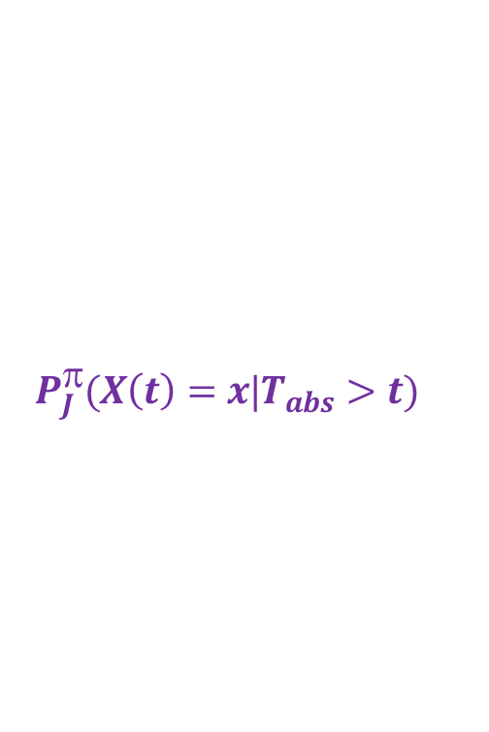
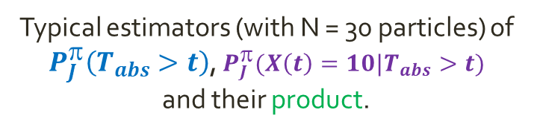
The Fleming-Viot particle system is used to estimate $P_{J}^{π}(X\left(t\right)=x|T_{abs}>t)$ (the state distribution conditioned to non-absorption)
Typical estimators (with N = 30 particles) of
$P_{J}^{π}\left(T_{abs}>t\right)$, $P_{J}^{π}(X\left(t\right)=10|T_{abs}>t)$
and their product.
R
R
S
A
R
The estimation of $P_{J}^{π}(X\left(t\right)=x|T_{abs}>t)$ (for each t) is surprisingly simple.
Let m_{N,t}(x) = “proportion of N particles in state x at time t”, then: $m_{N,t}\left(x\right)→P_{J}^{π}(X\left(t\right)=x|T_{abs}>t)$ as $N→∞$ with error ~ O($1/{\sqrt{N}}$)
Asselah, A.; Ferrari, P. A.; Groisman, P. (2011) “Quasistationary Distributions and Fleming-Viot Processes in Finite Spaces”
NOTE: In the general multidimensional-state space: Starting state J becomes “the outside boundary of attraction set A”.

Slide 21
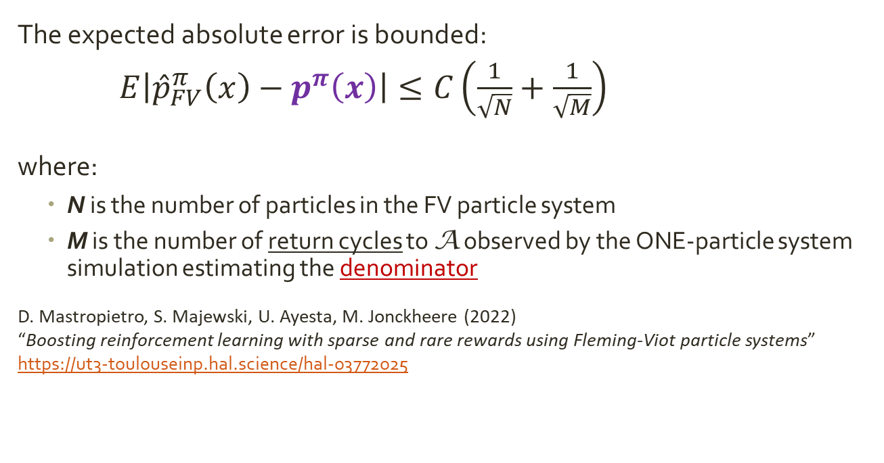

The Fleming-Viot estimator of p^{π}(x) is consistent
$$p^{π}(x)=\frac{\int_{0}^{∞}{P_{J}^{π}\left(T_{abs}>t\right)P_{J}^{π}(X\left(t\right)=x|T_{abs}>t)}dt}{Expected return time to J−1 under π}$$
The expected absolute error is bounded:
$E\left|{\hat{p}}_{FV}^{π}\left(x\right)−p^{π}\left(x\right)\right|≤C\left(\frac{1}{\sqrt{N}}+\frac{1}{\sqrt{M}}\right)$
where:
N is the number of particles in the FV particle system
M is the number of return cycles to A observed by the ONE-particle system simulation estimating the denominator
D. Mastropietro, S. Majewski, U. Ayesta, M. Jonckheere (2022) “Boosting reinforcement learning with sparse and rare rewards using Fleming-Viot particle systems” https://ut3-toulouseinp.hal.science/hal-03772025

Slide 22
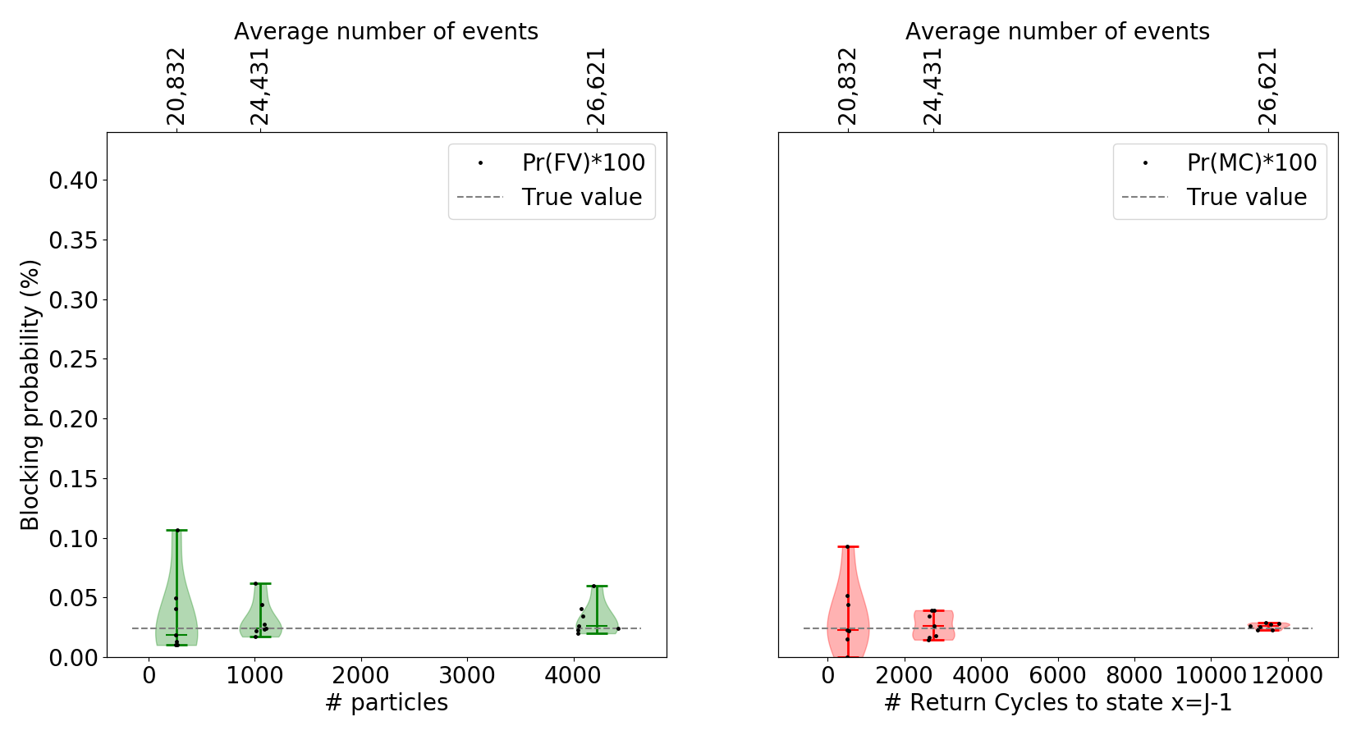
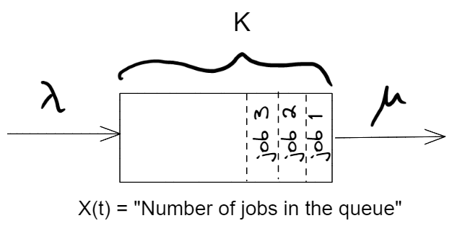
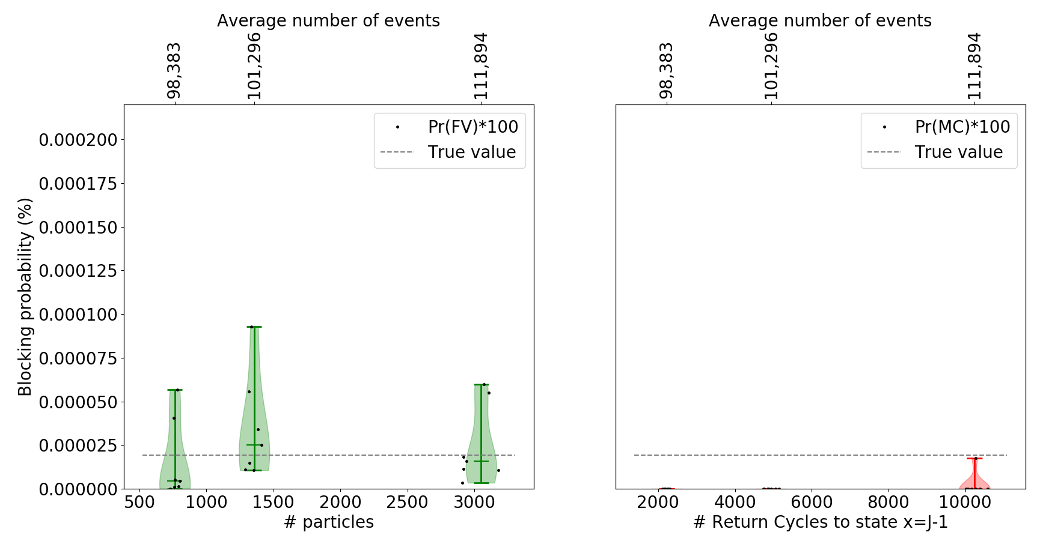
Experimental results: Fleming-Viot vs. Monte-Carlo estimation
Closer to horizontal dotted gray line and shorter violin plots is better
K = 20 True p(K) = 2.4E-4
FV hyperparameters:
N: # particles increases (horizontal axis)
T = 4000 arrivals
J = 12
10 replications per N
Fleming-Viot estimation
Monte-Carlo estimation
Same average number of events (for fair comparison)
λ = 0.7, μ = 1
N: # particles
# return cycles to J-1
K = 40 True p(K) = 1.9E-7
FV hyperparameters:
(same as above)
p(K) estimated as ZERO (except in one case)
N: # particles
# return cycles to J-1

Slide 23

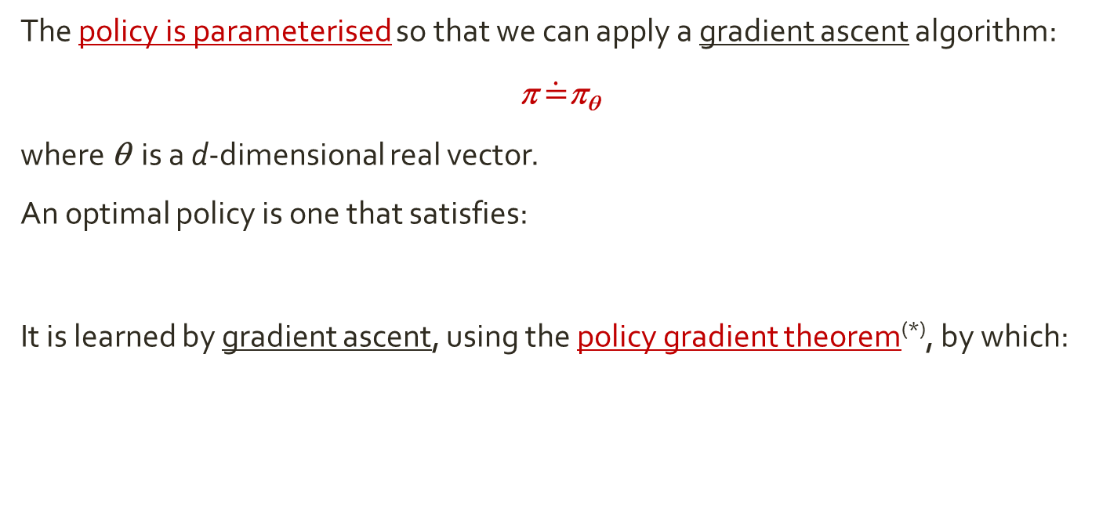


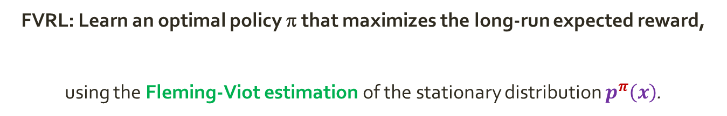
FVRL: Fleming-Viot Reinforcement Learning Fleming-Viot estimation combined with policy gradient
FVRL: Learn an optimal policy π that maximizes the long-run expected reward,
using the Fleming-Viot estimation of the stationary distribution $p^{π}\left(x\right)$.
$$E^{π}\left(R\right)=\sum_{x}{p^{π}\left(x\right)r(x)}$$
The policy is parameterised so that we can apply a gradient ascent algorithm:
π $\dot{=}$π_{θ}
where θ is a d-dimensional real vector.
An optimal policy is one that satisfies:
It is learned by gradient ascent, using the policy gradient theorem^{(*)}, by which:
$$π^{∗}\dot{=}π_{θ^{∗}}=\underset{θ∈ℝ^{d}}{argmax}{E^{π_{θ}}\left(R\right)}$$
$${∇E}^{π_{θ}}\left(R\right)\sim ∇π_{θ}$$
(*) E.g. see “Reinforcement Learning”, Sutton & Barto (2018), Ch. 13

Slide 24
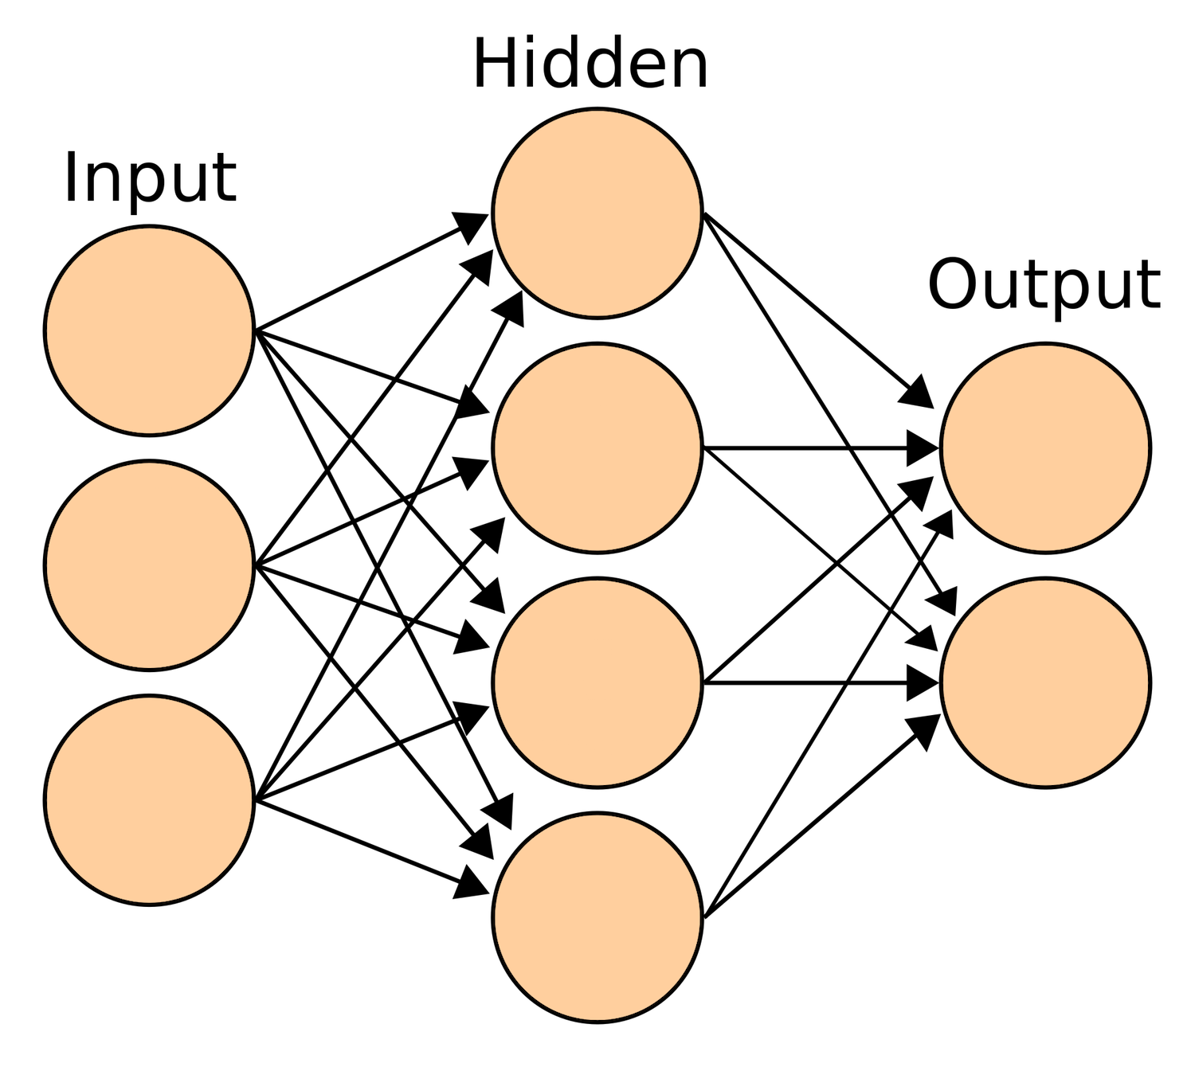
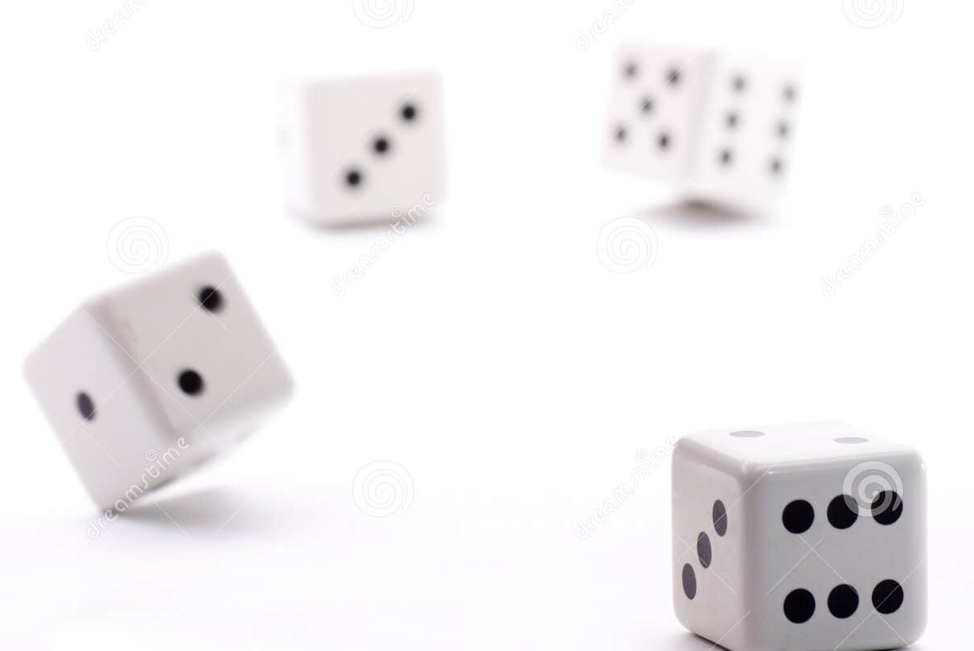

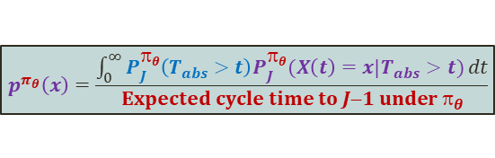
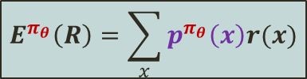


FVRL workflow
Define parameterized policy π_{θ}
E.g. Neural network model
states
π_{θ}(action|state)
Initialize θ = θ₀
E.g. Random walk policy
Regular excursion of MDP
Estimate absorption set A
E.g. Based on initial excursion and visit frequency threshold
R
R
S
A
Estimate $p^{π_{θ}}\left(x\right)$
for x outside A with
Fleming-Viot
particle system
R
$$p^{π_{θ}}\left(x\right)=\frac{\int_{0}^{∞}{P_{J}^{π_{θ}}\left(T_{abs}>t\right)P_{J}^{π_{θ}}(X\left(t\right)=x|T_{abs}>t)}dt}{Expected cycle time to J−1 under π_{θ}}$$
Fleming-Viot particle system
R
R
S
A
Repeat until convergence
Compute long-run expectation to maximize
R
$$E^{π_{θ}}\left(R\right)=\sum_{x}{p^{π_{θ}}\left(x\right)r(x)}$$
Fleming-Viot estimator of $p^{π_{θ}}\left(x\right)$ is biased but consistent.
Convergence guarantees of FVRL to local optimum.
Update θ
by gradient ascent
$${∇E}^{π_{θ}}\left(R\right)\sim ∇π_{θ}$$

Slide 25





Results (1): M/M/1/K queue Objective: find the optimal capacity K
M/M/1/K system
Possible actions:
Accept or Reject an incoming job
Reward landscape, r(x):
All ZERO, except at job rejection, with exponential cost
Service load: λ/μ = 0.7
Rejection cost: r(K) ~ -b^{K} (some b > μ/λ)
Function to maximize:
Long-run expected reward:
$$E^{π}\left(R\right)=p^{π}\left(K\right)r\left(K\right)$$
Define parameterized policy π_{θ}
Acceptance probability is
step function of θ ∈ℜ
=> Policy gradient ≠ 0, only at θ = K-1
$$π_{θ}$$
0 < $π_{θ}$< 1
θ
K-1
θ+1
K
Initialize θ = θ₀
Initial policy:
Reject at large K = 28
Probability(K) = 10⁻⁵
Estimate absorption set A
States with
visit frequency > 0.5%
Size of absorption set A:
~ K/3
θ_{t}
x
Result of policy learning loop
Function to
optimize
Long-run expected reward: $E^{π}\left(R\right)$ (log-scale)
θ_{t+1}
K*

Slide 26


Results (1): M/M/1/K queue Objective: find the optimal capacity K
M/M/1/K system
Possible actions:
Accept or Reject an incoming job
Reward landscape, r(x):
All ZERO, except at job rejection, with exponential cost
Service load: λ/μ = 0.7
Rejection cost: r(K) ~ -b^{K} (some b > μ/λ)
Function to maximize:
Long-run expected reward:
$$E^{π}\left(R\right)=p^{π}\left(K\right)r\left(K\right)$$
FVRL setup:
- # particles < 100: smaller as K becomes smaller
- # queue transitions per policy learning step ~ 4,000
Monte-Carlo setup:
- Same number of queue transitions as Fleming-Viot per policy learning step
Long-run expected reward: $E^{π}\left(R\right)$ (20 replications)
1) FVRL
2) Monte-Carlo
θ(t)
K*
θ_{t}
x
Result of policy learning loop
FVRL reaches the optimum K* much faster than Monte-Carlo
θ_{t+1}
Policy learning step (100 steps)

Slide 27



Results (2): Loss Network Objective: find optimal capacities K(l)
M/M/L/S system
L = 2 job classes
S = 6 servers
Rejection cost depends on the job class: R(l)
One policy π(l) for each job class
Multidimensional problem: θ ∈ ℜ²
$$π_{θ}$$
Acceptance probability is
step function of θ (l) for each class job l.
x(l): No. of jobs of class l being served
μ
λ₁
λ₂
Dispatcher
μ
L job classes
S servers
…
…
λ_{L}
S
μ
R

Slide 28

Results (2): Loss Network Objective: find optimal capacities K(l)
M/M/L/S system
L = 2 job classes
S = 6 servers
Rejection cost depends on the job class: R(l)
One policy π(l) for each job class
Long-run expected reward: $E^{π}\left(R\right)$ (20 replications)
1) FVRL
2) Monte-Carlo
K*(1)
FVRL reaches the optimum K* much faster than Monte-Carlo
μ
K*(2)
λ₁
λ₂
Dispatcher
μ
L job classes
S servers
…
…
λ_{L}
μ

Slide 29
Assumptions and limitations
Optimisation problem: The objective function must be written as a long-run expectation of a measure of interest. (e.g. long-run expected reward or cost)
System / Environment characteristics:
A “black-box” simulator or emulator is needed. (e.g.it is NOT possible to apply the method on previously collected data)
Finite number of states (for convergence guarantees).
References:
Paper for FVRL on stochastic networks: https://link.springer.com/article/10.1007/s11134-025-09950-5, “Fast-exploring reinforcement learning with applications to stochastic networks”, Queueing Systems, Vol. 109 (2025) (open access)
Fleming-Viot particle systems: A. Asselah, P.A. Ferrari, and P. Groisman. “Quasi-stationary distributions and Fleming-Viot processes in finite spaces”. J. Appl. Probab., 48(2):322–332, 2011

Slide 30




Fleming-Viot
METHODOLOGY
Fleming-Viot ESTIMATION
Fleming-Viot
CONTROL
Questions?
$$p^{π}(x)=\frac{\int_{0}^{∞}{P_{J}^{π}\left(T_{abs}>t\right)P_{J}^{π}(X\left(t\right)=x|T_{abs}>t)}dt}{Expected return time to J−1 under π}$$
Daniel.Mastropietro@gmail.com
Univ. Toulouse (IRIT), France Main reference: https://link.springer.com/article/10.1007/s11134-025-09950-5

